Slide 1




Slide 2
Presented by:
Jaspreet Kaur Chagger , Rahul Mathur , Mohd Azim & Prashant Chauhan
Problem Statement: Automation
Solution Adopted: Automation
Problem Statement: Performance
Solution Adopted: Performance
Problem Statement: Manual Test Approach
Solution Adopted: Test Approach

Slide 3


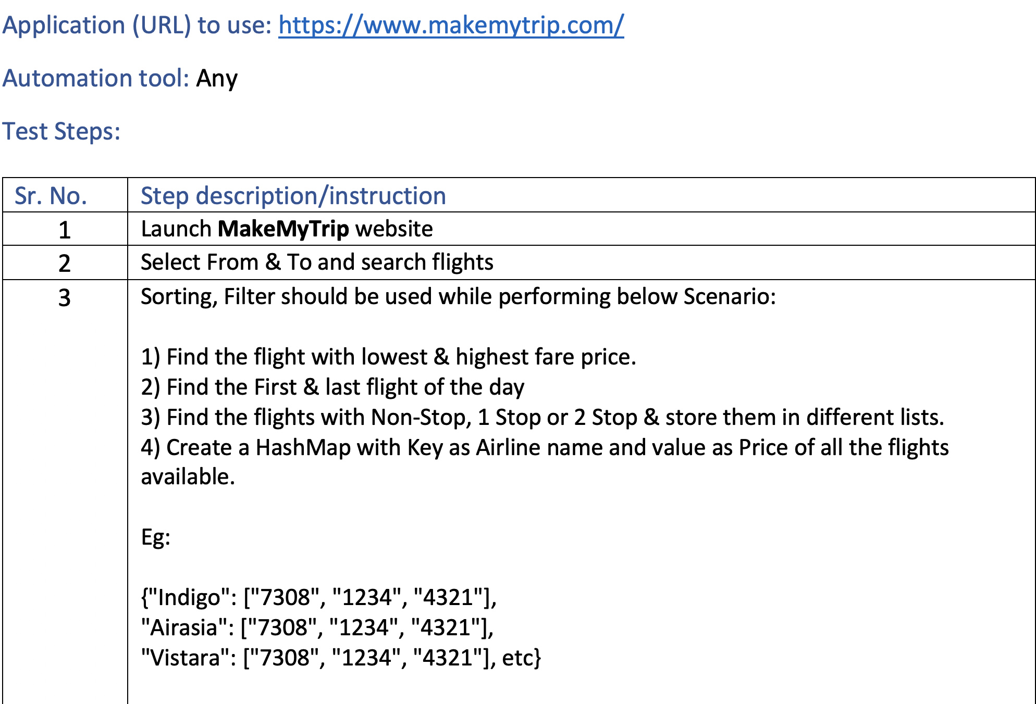


Problem Statement
@2020 Nagarro - All rights reserved

Slide 4
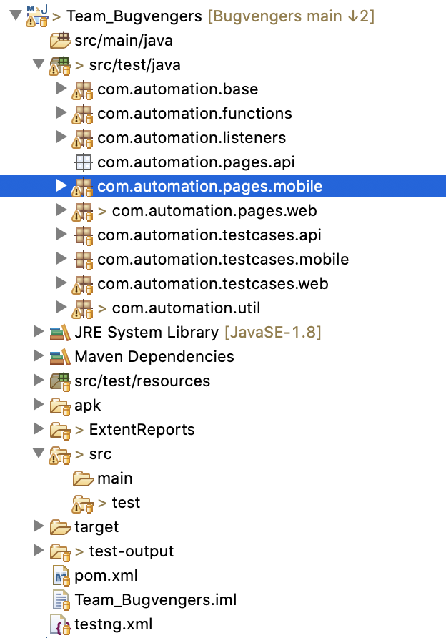
Solution Adopted
Common automation framework created for API, Web and Mobile Tests
Framework is based on Java, TestNg and Maven
Leverages Rest Assured for API, Selenium for Web and Appium library for Mobile Automation
Supports Parallel execution
Tests can be run via command line
Logging of Test Failures and Test success using ITestListner
Test reporting via Extent reports
Screenshot capture on Test success (Configurable) and Test Failures
Automatic download of Browser drivers based on browser selected for web test
Based on Page Object Model
Page Factory Design pattern for Page classes
@2020 Nagarro - All rights reserved

Slide 5
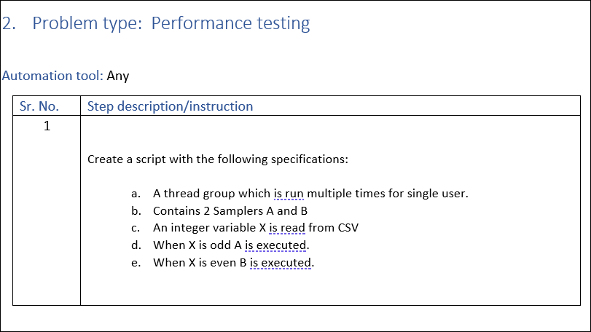
Problem Statement: Performance
@2020 Nagarro - All rights reserved

Slide 6
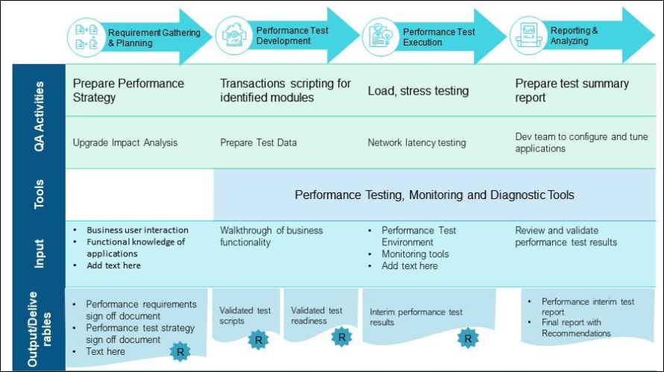
Approach for Performance test activities and deliverables
@2020 Nagarro - All rights reserved

Slide 7
High-Level Performance Testing Plan
Review Performance Impacting Scenarios
Finalize Performance Testing Scenarios
Scripting of Individual Scenarios and Merge/integrate all Scenarios
Verification test with industry standard think time
Based on production data analysis, finalize User Load Distribution/Think Time
Test Data Setup & Verify
Script Verification/Update + Dry Run
Performance testing Environment Setup and Warm-up Test
Execute Load Test Run & Share Test Result Summary
The first two tests would be a break point test, the test will be executed in a step-up manner to find the breakpoint of the application based on number of users.
The third step will be a benchmarking test to confirm the metrics obtained from first test and establish a benchmark for current performance.
After the fixes/upgrades on the application we will execute a baseline test to compare the metrics between previous and current version.
Scalability, Stability test runs
Detailed Performance Test Analysis Report
Regress Test after fixing performance issues
Benchmark Application Performance
@2020 Nagarro - All rights reserved

Slide 8
Solution Adopted: Performance Testing
@2020 Nagarro - All rights reserved

Slide 9
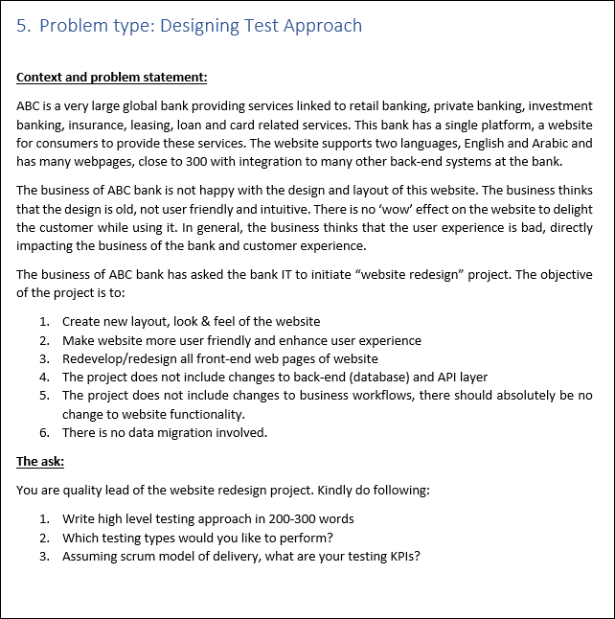
Problem Statement – Test Strategy
@2020 Nagarro - All rights reserved

Slide 10
Solution – Test Approach
Functional Testing Types | Non-Functional Testing Types
Unit Testing | Performance Testing
Integration Testing | Scalability Testing
System Testing | Usability Testing
System Integration Testing | Hardware Configuration Testing
User Acceptance Testing | Security Testing
Test Environment Used: QA ,Load Test Environment, Demo and Prod Test Data: Excel, Json and xml files Test Approach:
@2020 Nagarro - All rights reserved

Slide 11
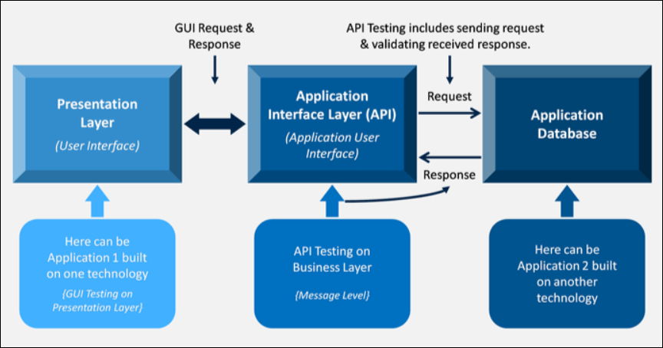
Approach for API Testing
@2020 Nagarro - All rights reserved

Slide 12

Thank You

